Slide 1
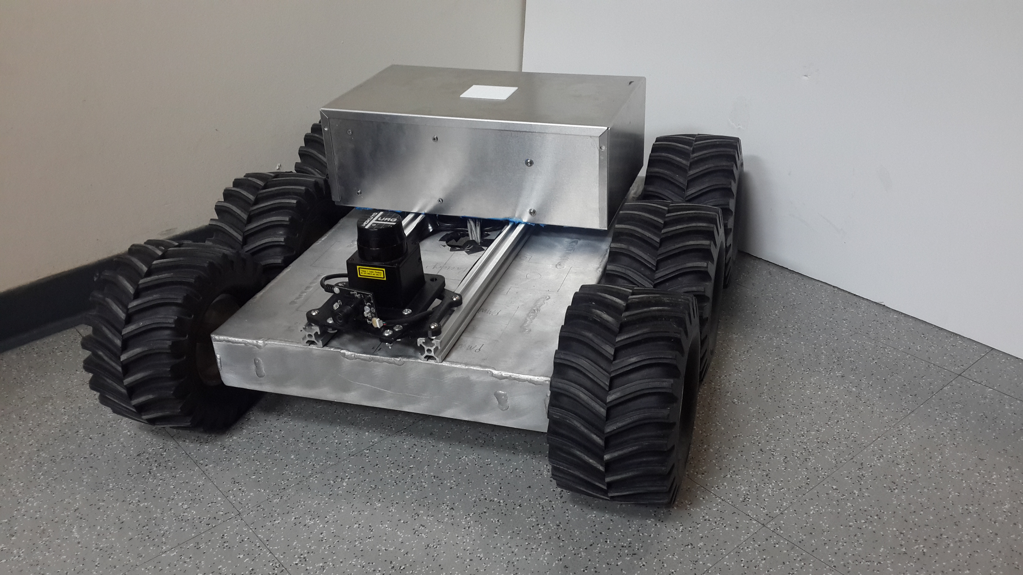

Simultaneous Localization And Mapping on an Integrated Mobile Platform
Agraj Jain
Advisor: Dr. Farshad Khorrami
5/18/2015

Slide 2
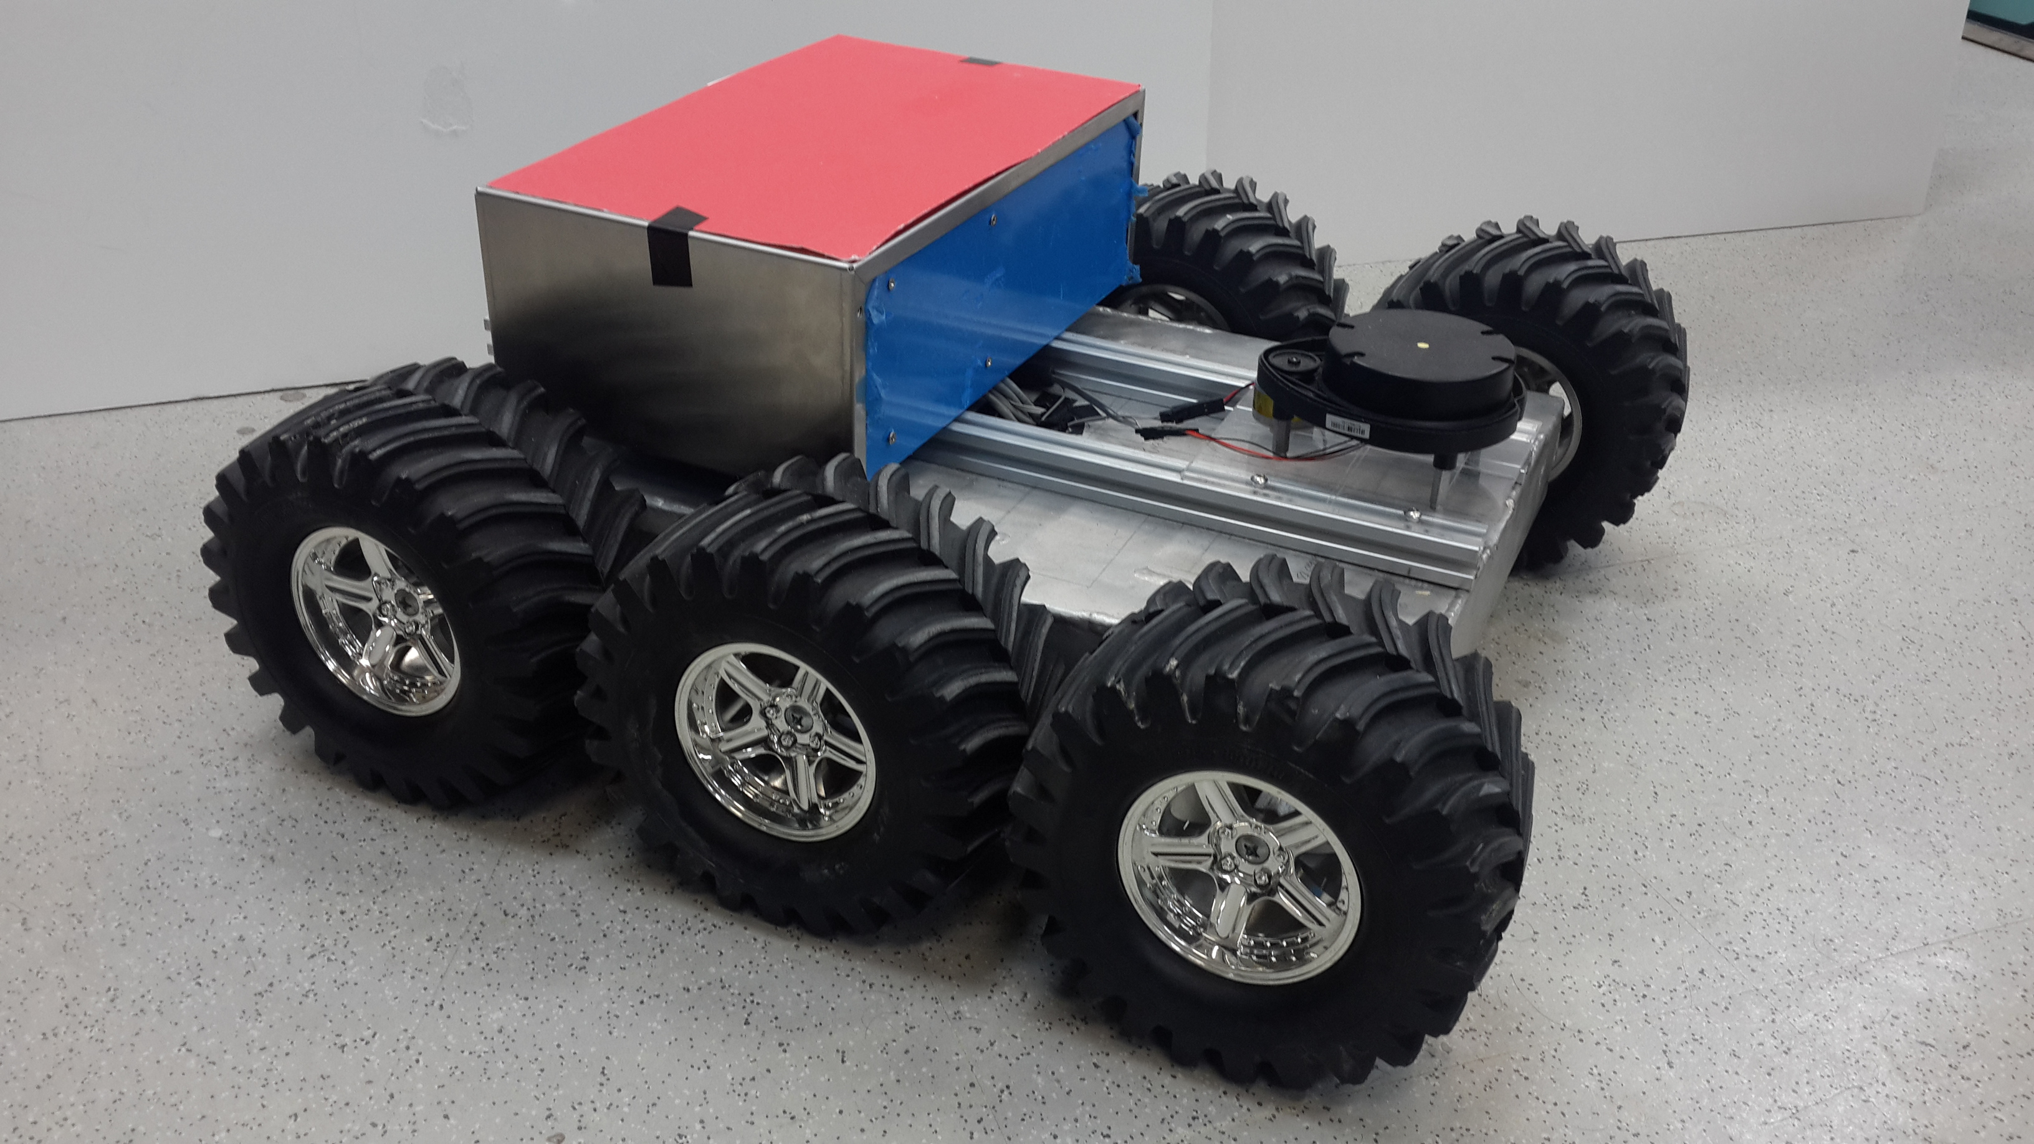
Overview
Overview of Presentation
Overview of SLAM
Design of the Integrated Mobile Platform
Feature Detection Algorithms
Results
Concluding Remarks

Slide 3
Overview of SLAM

Slide 4
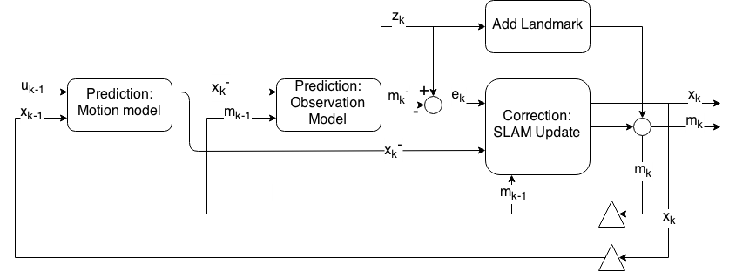
Overview of SLAM
SLAM PROCESS

Slide 5
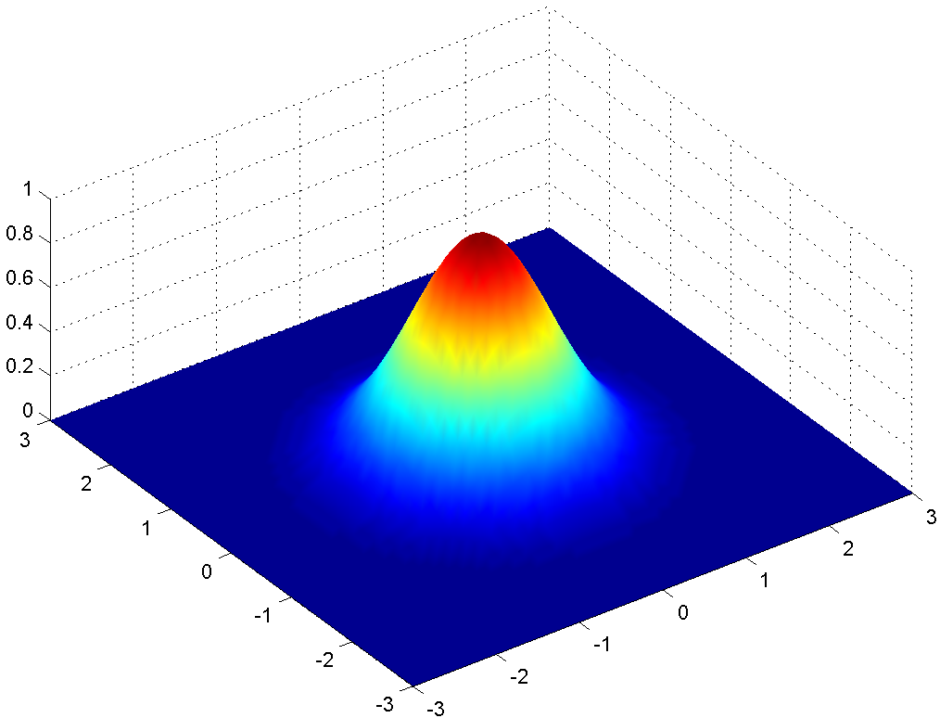
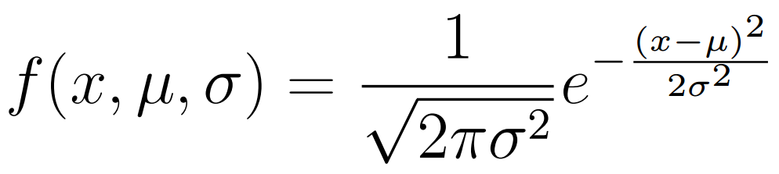
Overview of SLAM
Gaussian Filters
All values assumed to have normal p.d.f:
Robot pose
Environmental Features
Control inputs
Measurements

Slide 6
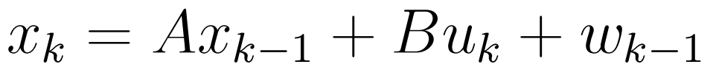
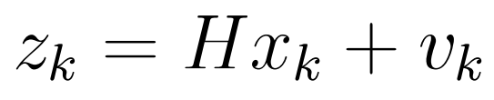
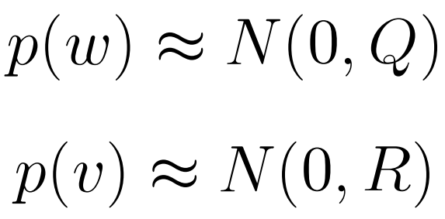
Overview of SLAM
KALMAN FILTER
System Dynamics:
Noise Covariance:

Slide 7
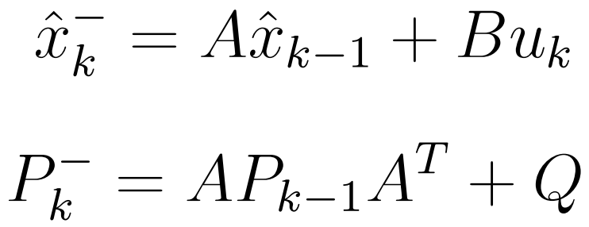
Overview of SLAM
Prediction equations:

Slide 8
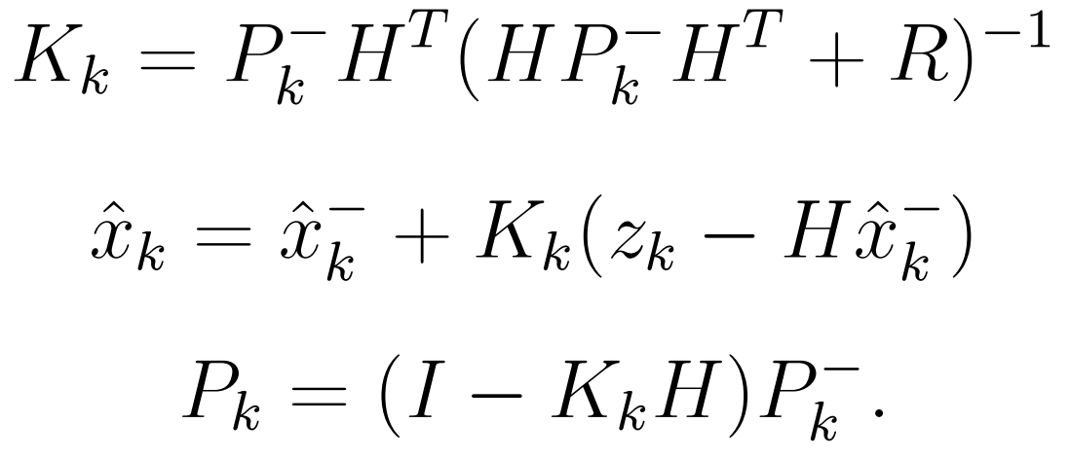
Overview of SLAM
Correction equations:

Slide 9
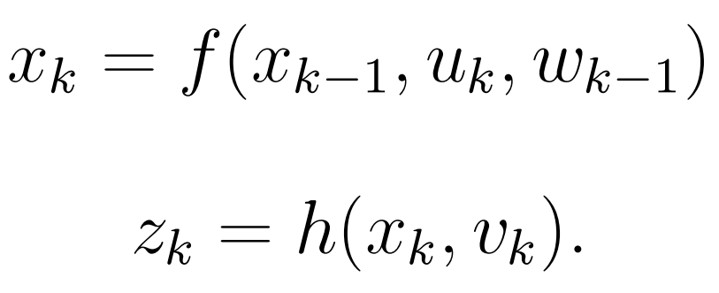
Overview of SLAM
EXTENDED KALMAN FILTER
System Dynamics:
Noise Covariance:

Slide 10
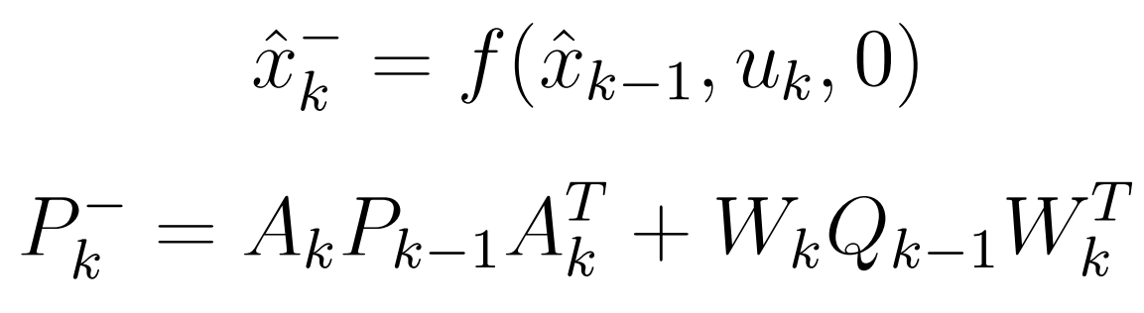
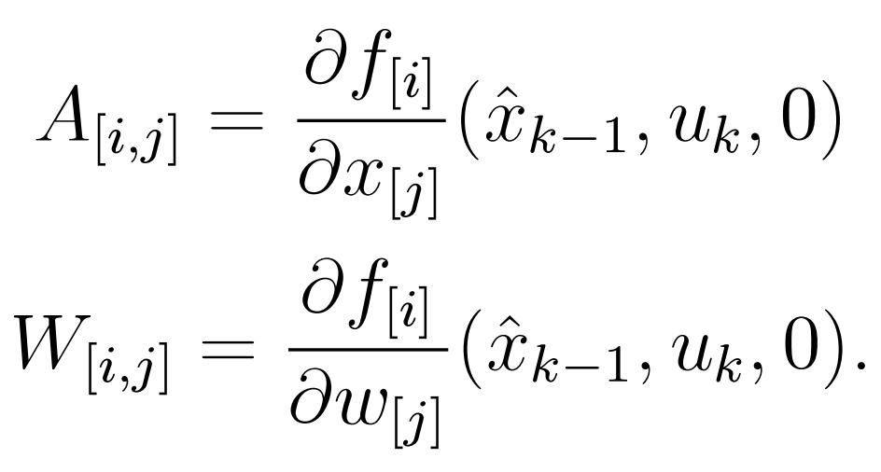
Prediction equations:

Slide 11
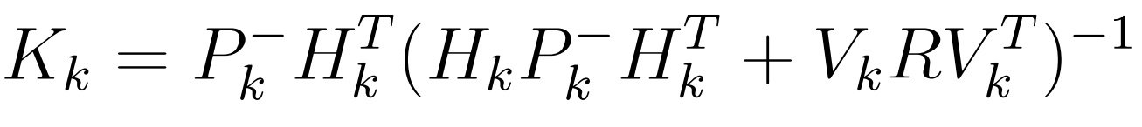
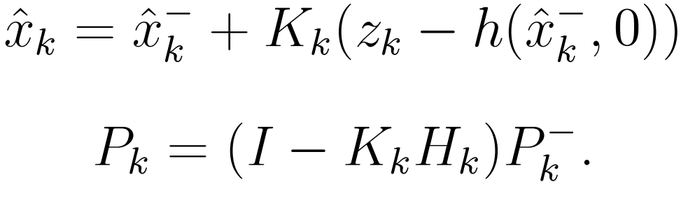
Overview of SLAM
Correction equations:

Slide 12
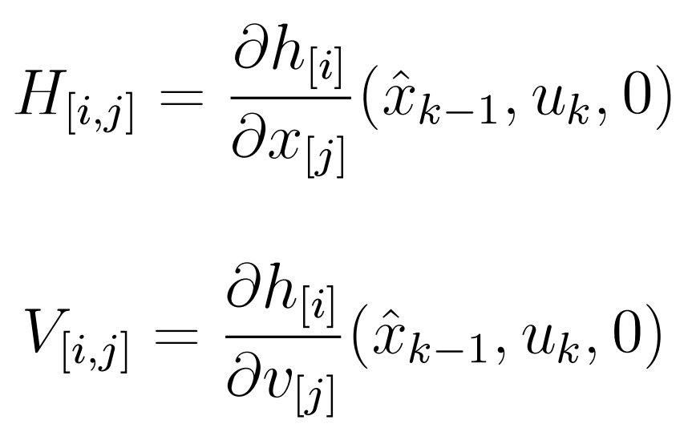
Overview of SLAM
Correction equations:

Slide 13
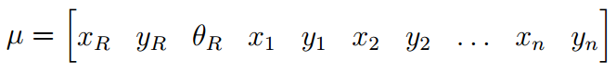
Overview of SLAM
Extended Kalman Filter based SLAM
State vector is a combination of Robot pose and map

Slide 14
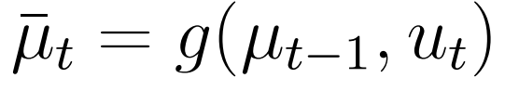
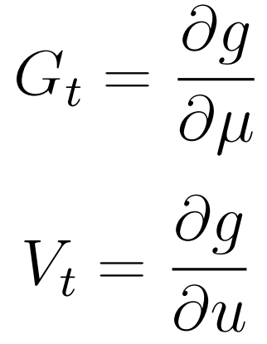
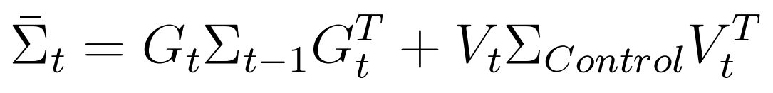
Overview of SLAM
Prediction Equations:

Slide 15
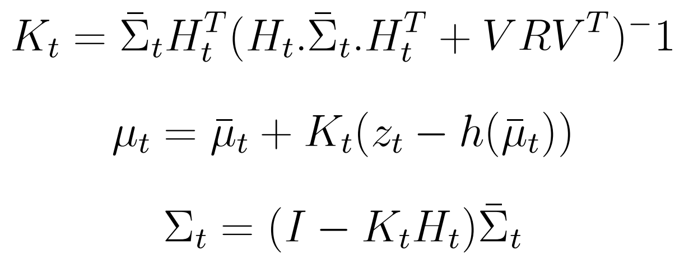
Overview of SLAM
Correction Equations:

Slide 16
Integrated Mobile Platform:
Design and Implementation

Slide 17
The Integrated Mobile Platform

Slide 18
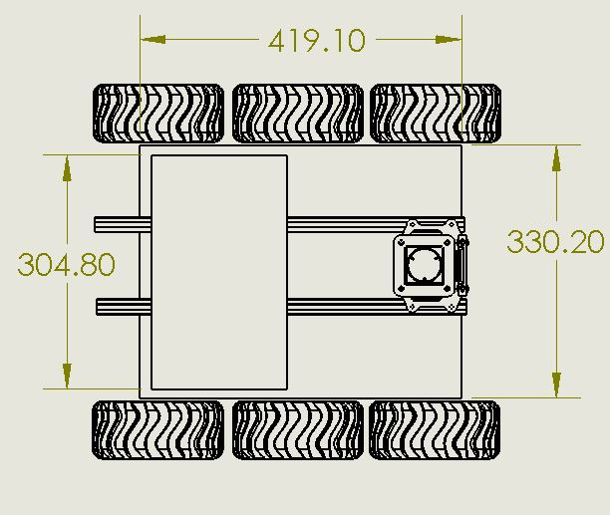
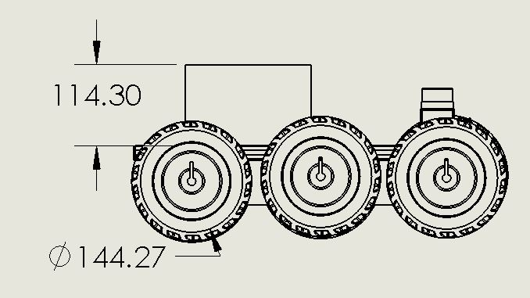
Mechanical Design

Slide 19
Computational and Sensory Payload
AutoPilot (IMU, pressure sensor, temperature sensor)
ODROID-XU computer
MA 3 Miniature Absolute Magnetic Shaft Encoders
Leapord Imaging 5MP Camera
Hokuyo-URG LIDAR
TP-Link Nano Wireless Module
XBEE Wireless Radio

Slide 20
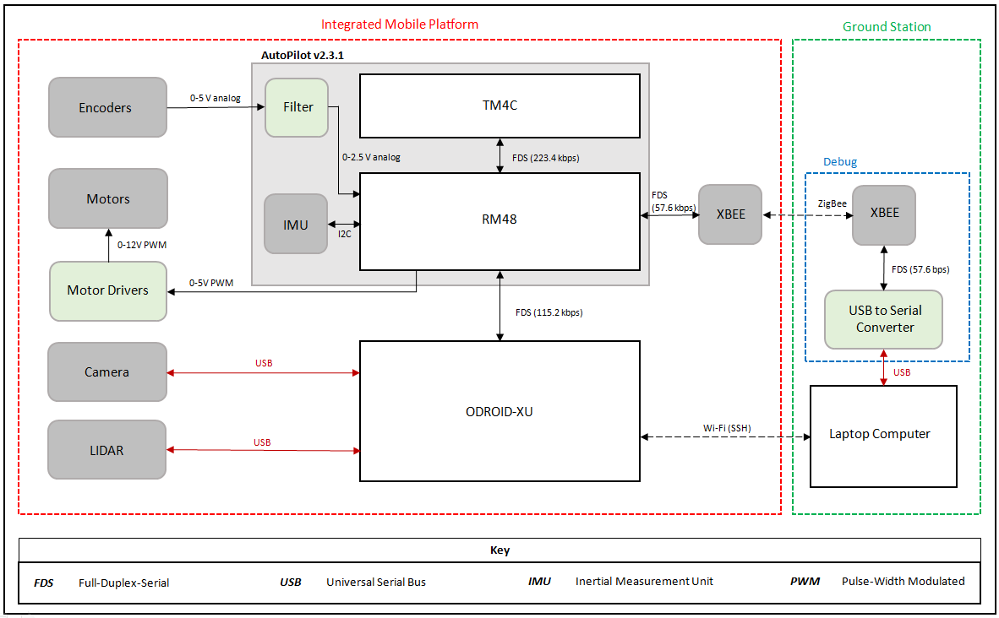

Slide 21
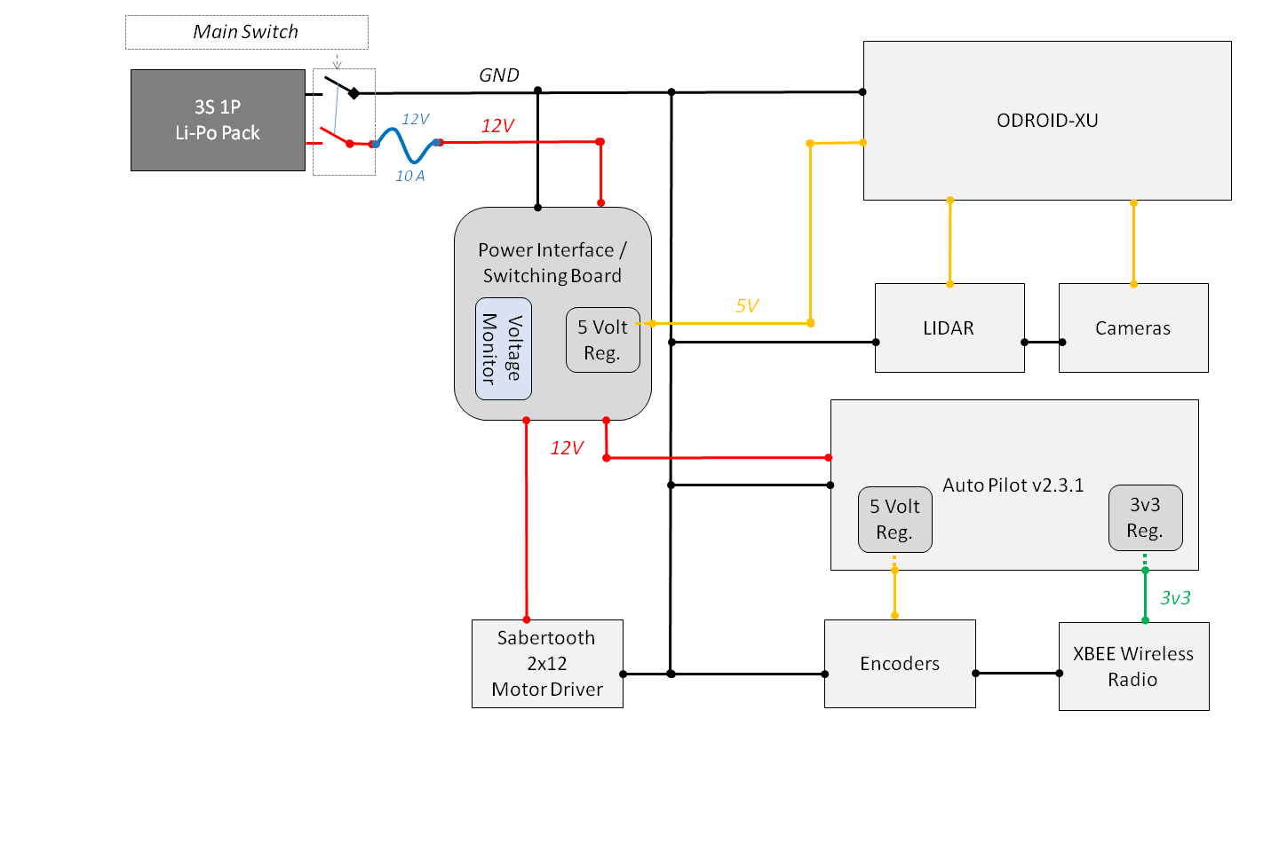
Power Routing Diagram

Slide 22
Feature Detection with LIDAR

Slide 23
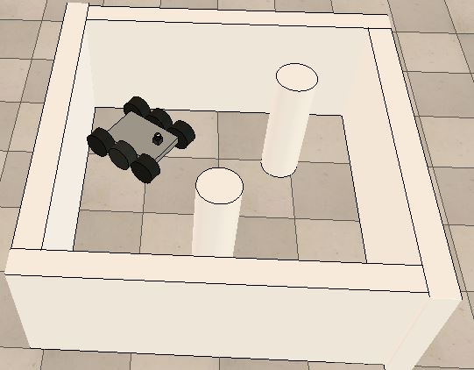
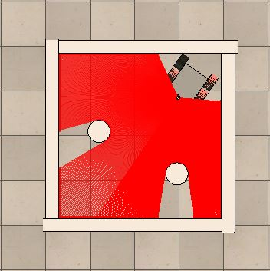
Point Features: A simplistic approach
Point Features: A simplistic approach
Simulated Arena

Slide 24
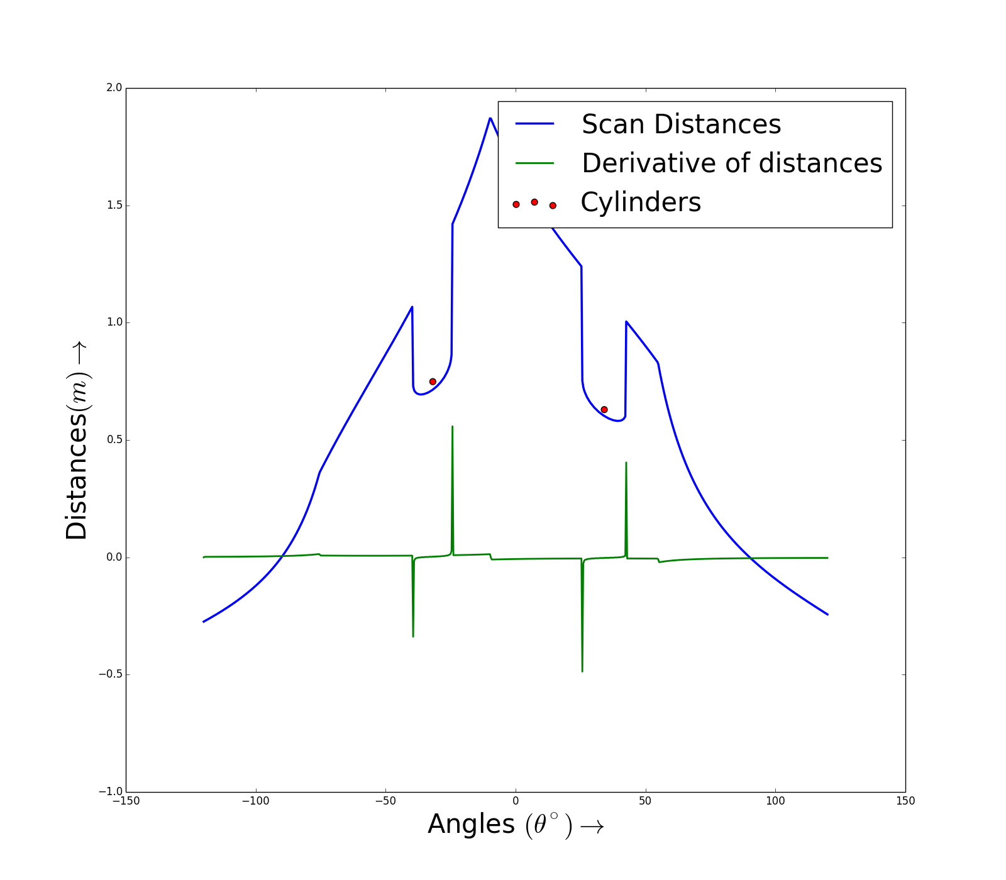
Point Features: A simplistic approach

Slide 25
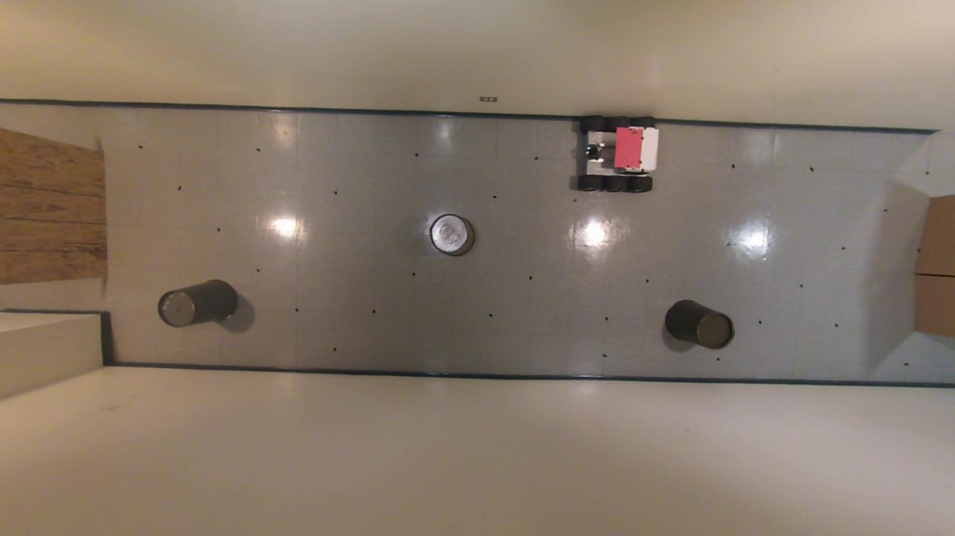
Point Features: A simplistic approach
Real World Environment

Slide 26
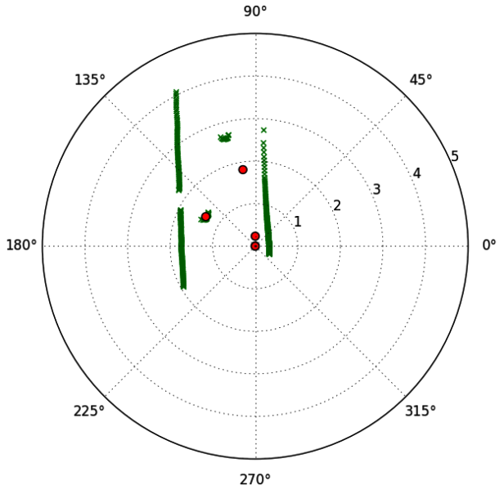
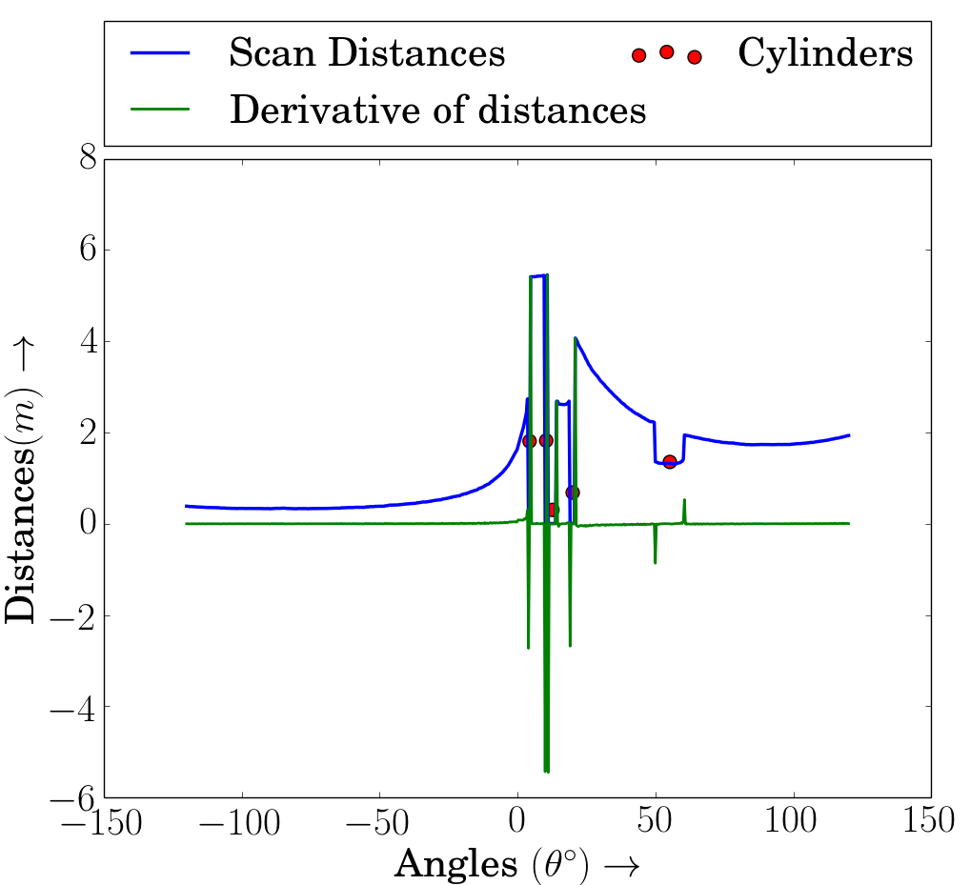
Point Features: A simplistic approach
Spurious Cylinders Seen with Simplistic approach

Slide 27
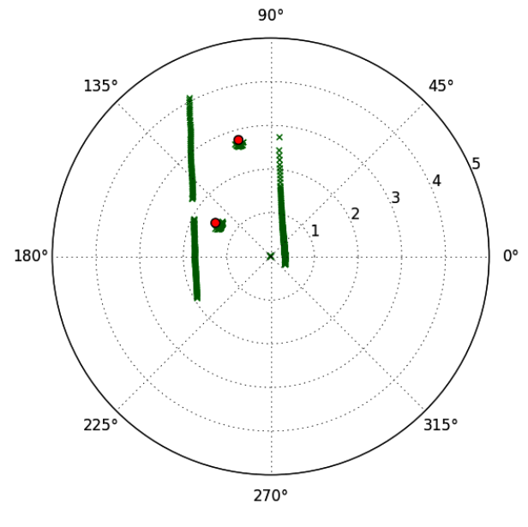
Point Features: A simplistic approach
Modifications to the algorithm
Filters added:
Minimum non-zero point count
Approximate angular width
Sufficient curvature

Slide 28
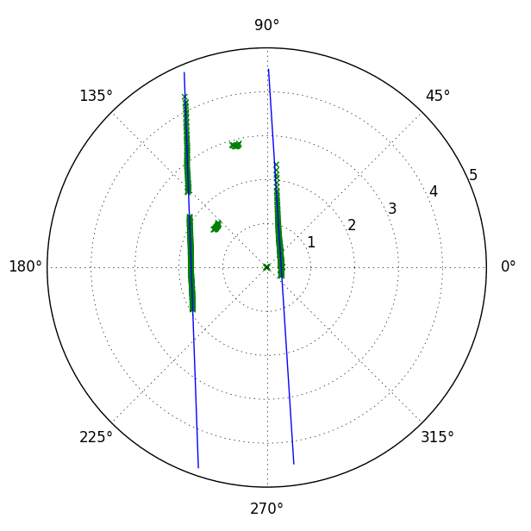
Linear Feature Extraction
Linear Feature Extraction
RANSAC based algorithm

Slide 29
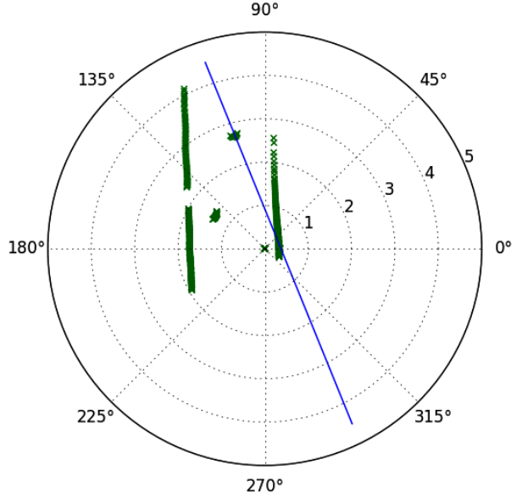
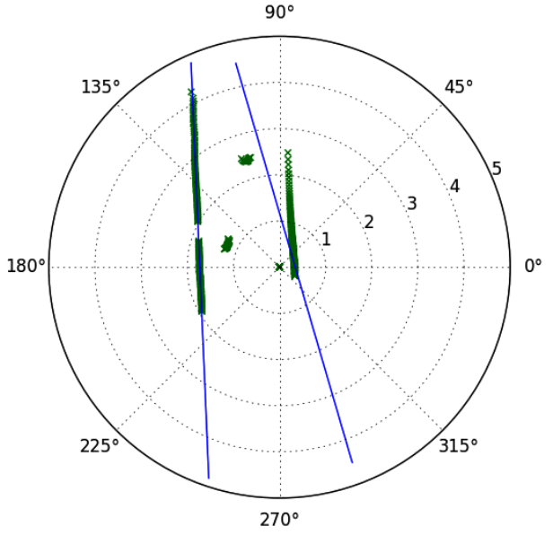
Linear Feature Extraction
Drawbacks of RANSAC based algorithm

Slide 30
Linear Feature Extraction
Linear Feature Extraction
HOUGH Transform based algorithm

Slide 31
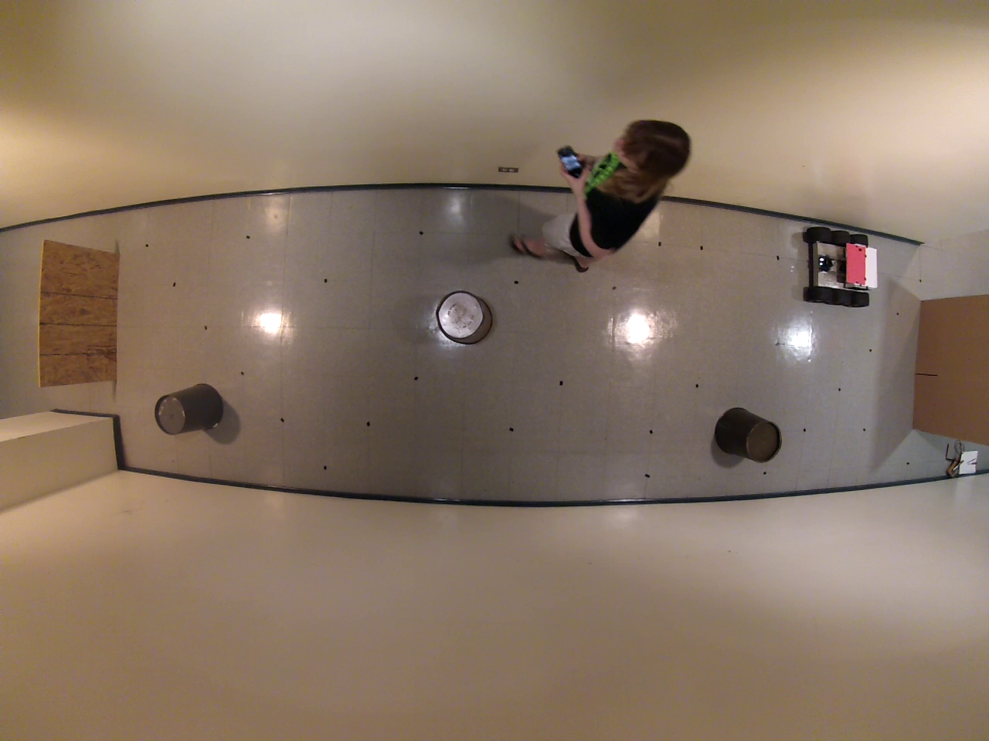
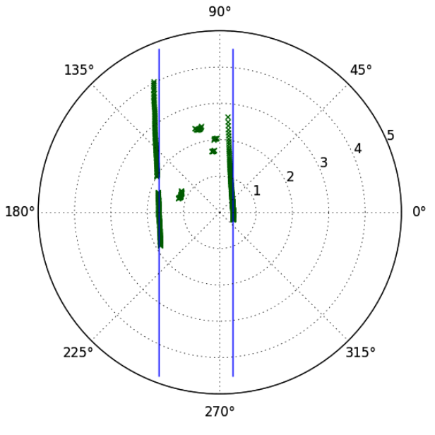
Linear Feature Extraction
Example 1 of Robustness of Hough Transform

Slide 32
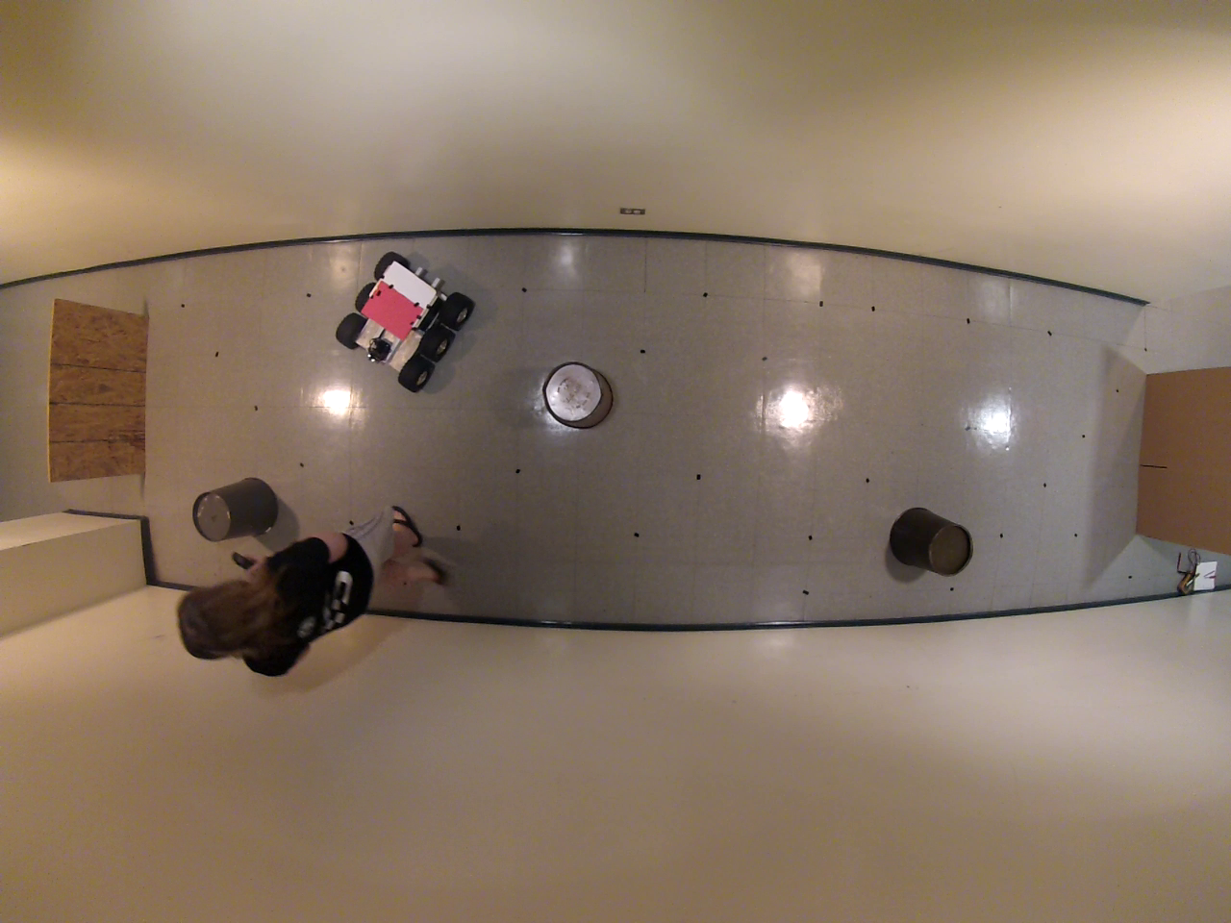
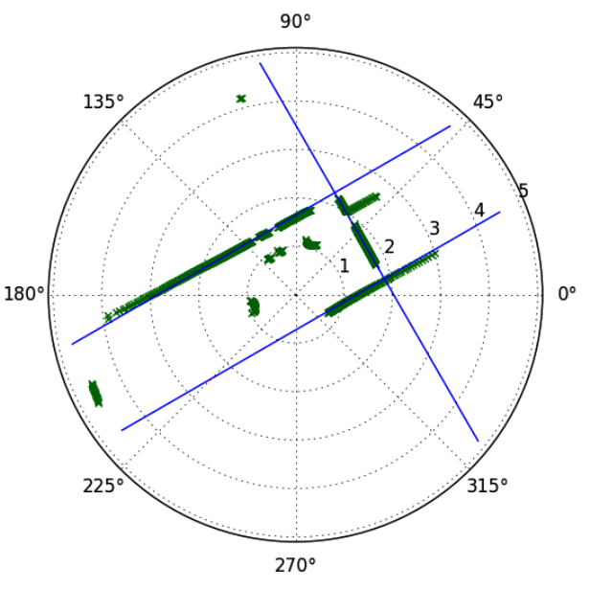
Linear Feature Extraction
Example 2 of Robustness of Hough Transform

Slide 33
Results

Slide 34
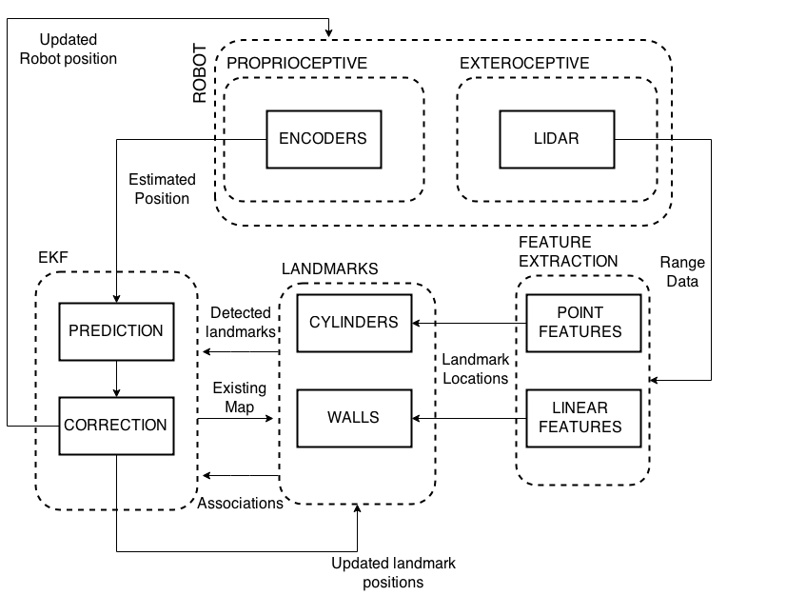
Results of SLAM
Modular Implementation of SLAM

Slide 35
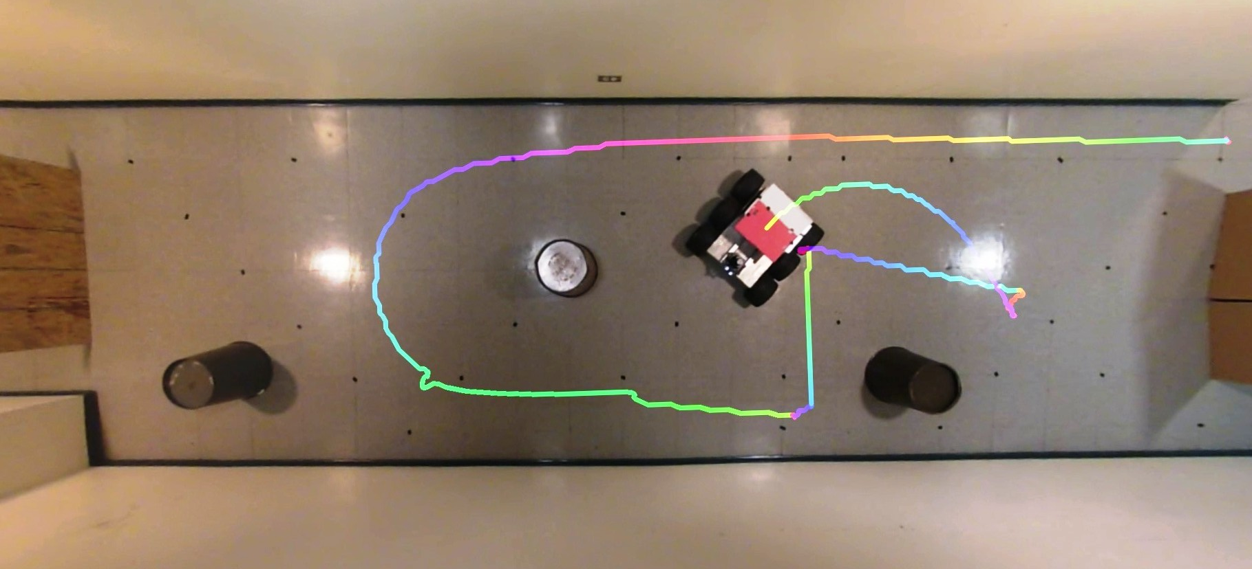
Results of SLAM
Path reconstructed by overhead camera

Slide 36
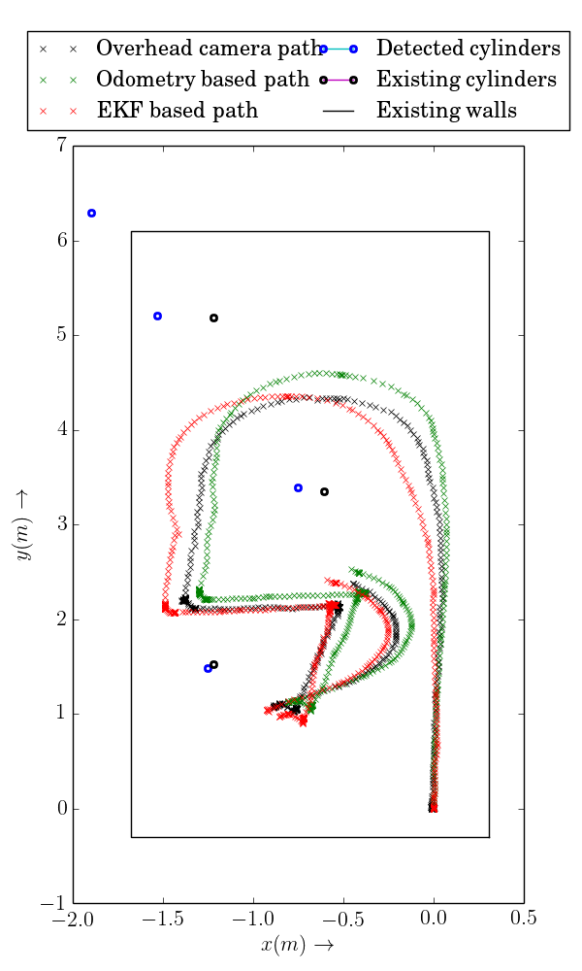
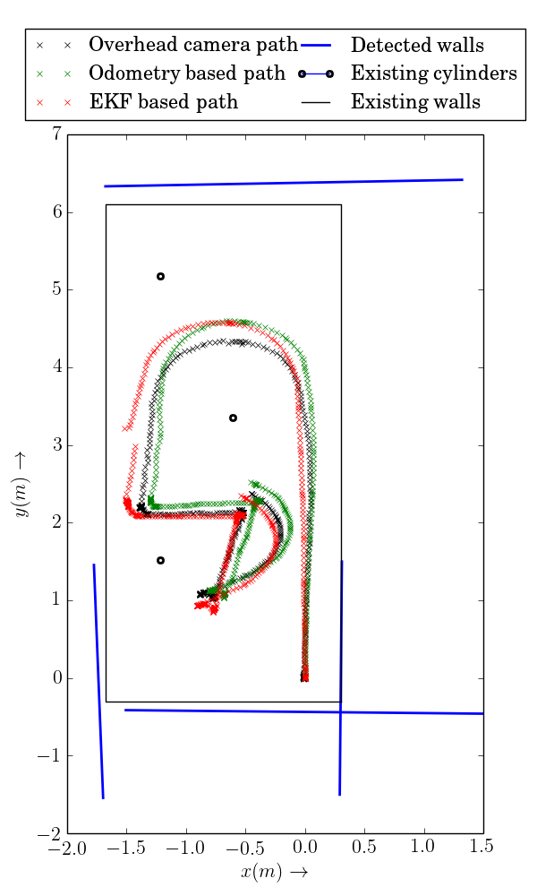
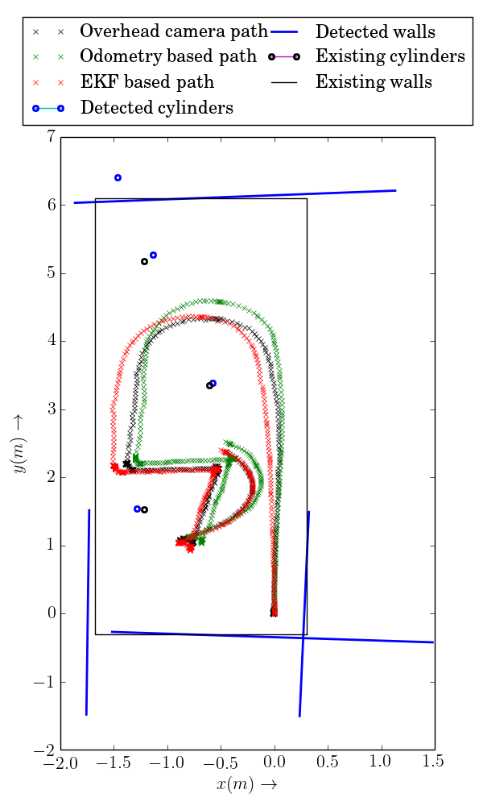
Results of SLAM
Point Features
Linear Features
Both in combination

Slide 37
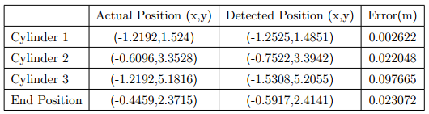
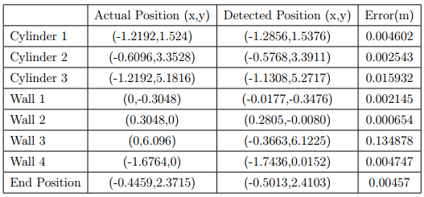
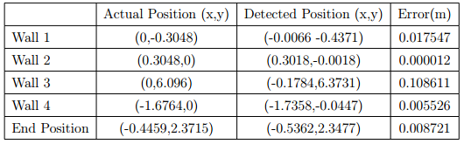
Results of SLAM
Individual Feature detectors:
Both detectors in combination:
Error reduction in end position of the robot:
80% compared to point features
47.5% compared to linear features

Slide 38
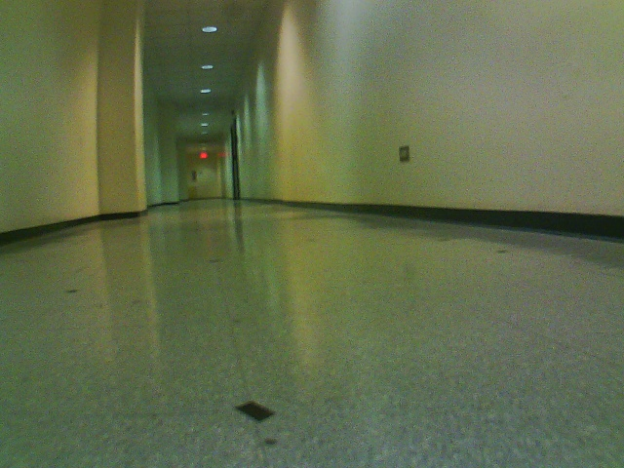

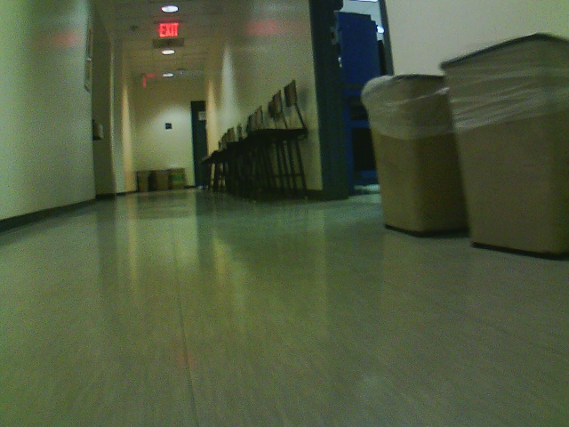
Results of SLAM
SLAM in uncontrolled Environment

Slide 39
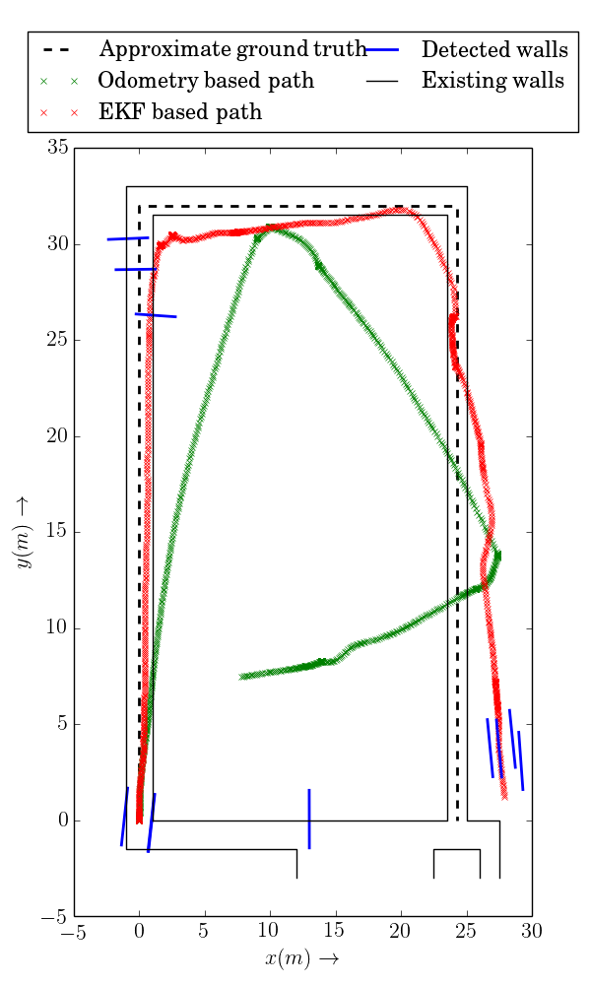
Results of SLAM
Reconstructed path using SLAM with linear features

Slide 40
Concluding Remarks

Slide 41
Concluding Remarks
Future Directions
Robust algorithms for point feature extraction
Fusing Camera and LIDAR data
Implementing SLAM in real time.
Using robust feature detectors for generic features
Notes:
Backprop
Bold driver

